Slide 1
HR ANALYTICS
EMPLOYEE ATTRITION ANALYSIS
Intro to BA Final Project
Team Humor Resources(HR)Inc.
Foster Mosden, Icy Wang, Neil Jiang, Hayley Huang

Slide 2

Table of Contents
Business Understanding
Evaluation
Deployment
Data Understanding
Q&A
Data Preparation
Citation
Modeling
1

Slide 3




Business Understanding Predicting Employee Attrition
Factors Impacting Revenue
Cost Breakdown
Quality of Employees
Quality of Products
Marketing and Sales Efforts
Cost of Goods Sold
Administrative Costs
Training and Development Costs
Sales and Marketing Costs
HR plays a key role in developing, reinforcing and changing the culture of an organisation.
2
Notes:
"Today, we're zooming in on the intricate relationship between employee attrition and its impact on business success.
A company's success dynamic has two parts: revenue growth and cost reduction. When we talk about revenue growth, the talent and expertise of our workforce are paramount. Exceptional employees drive growth, innovate, and lead the company to success. On the flip side, when we consider costs, those costs associated with maintaining our workforce stand out as substantial.
In essence, HR is more than just a department; it's a pivotal player in determining a company's success. Grasping and predicting employee attrition can significantly sway both revenue and costs, underscoring its vital importance."

Slide 4
Business Understanding
Cost Savings
Tackling high employee attrition problem with data science would add business value in:
Employee turnover is expensive, as it involves costs related to recruitment, training, and onboarding of new hires
Predictive models can help reduce these costs by enabling early intervention and retention strategies
Talent Retention
High employee turnover harms the stability of an organization
Retaining critical, high-value talent becomes easier when attrition risks are identified early, thereby enhancing the company's human capital and overall value
Productivity and Continuity
Frequent employee turnover can disrupt workflow, reduce productivity, and lead to knowledge loss. Also, if an employee left unexpected, the projects they were involved in would have risks getting delayed
Building predictive models to get ahead of situation alike would save companies from reputation loss among consumers and partners
3

Slide 5

Business Understanding
Predicting Employee Attrition
According to a study conducted by the Society for Human Resource Management (SHRM) , in total, voluntary employee attrition costs U.S. businesses $1 trillion every year. According to a study by SHRM, the average turnover cost per employee is equivalent to 6-9 months of an employee’s salary, while others state it could cost up to two times the employee’s annual salary.
Predicting employee attrition can improve an organization’s business advantages
Objective:
Build predictive models to predict whether or not a employee will leave the company in the immediate future
4

Slide 6





Data Understanding Dataset
Source
Content
Source
Target Variable
HR Analytics Dataset for Employee Attrition Analysis provided by an anonymous company’s HR deparment
Over 4,000 employees, comprehensive data including demographics, employment, working records in year 2015
The attrition status of each employee in 2016 (Yes/No)
5

Slide 7
Data Understanding
Employment Details
Personal Information
Continuous: Age, DistanceFromHome
Ordinal: Education
Categorical: EducationField, MaritalStatus
Binary: Gender, Over18
Work Information
Ordinal: BusinessTravel (level depending on frequency), JobLevel, TotalWorkingYears
Categorical: Department, JobRole
Constant Feature: StandardHours
Time: Daily in_time, out_time
Index: id, EmployeeID
Compensation & Promotion
Continuous: MonthlyIncome
Ordinal: TrainingTimesLastYear, YearsSinceLastPromotion, YearsAtCompany, YearsWithCurrManager
Categorical: StockOptionLevel
01
02
03
6

Slide 8
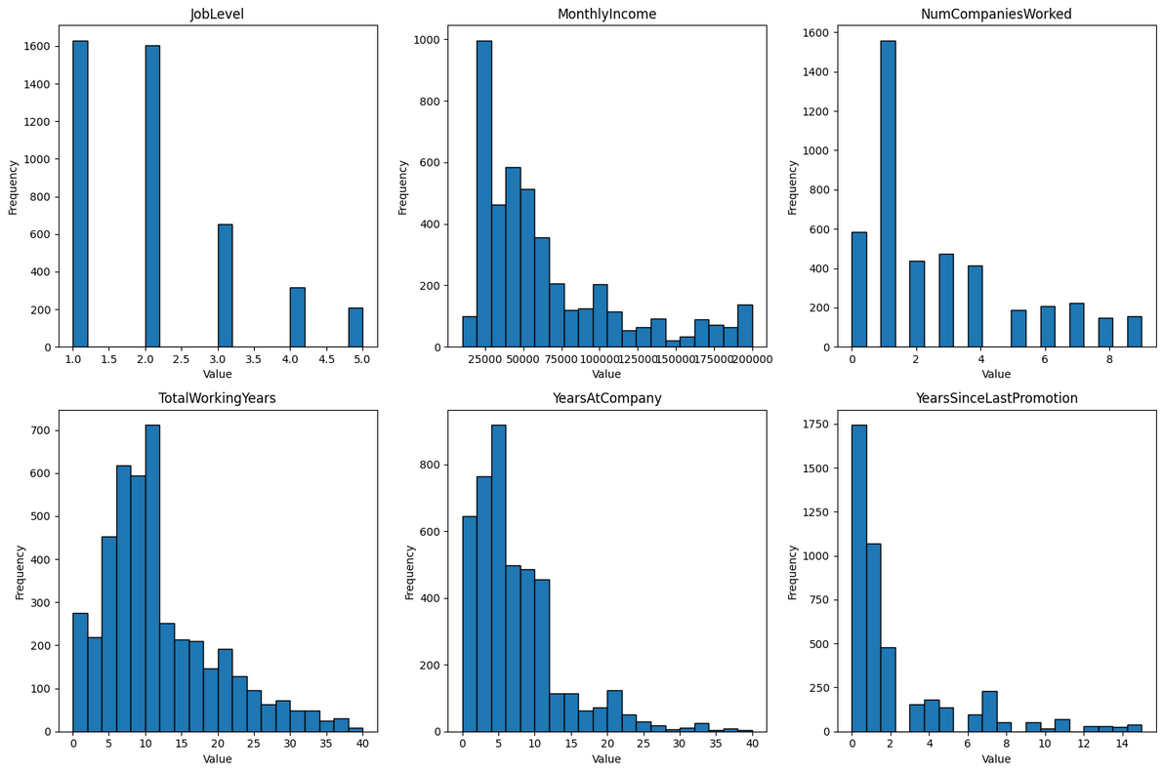
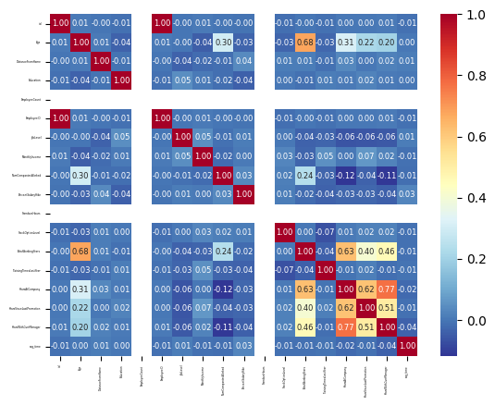
Data Understanding
Data Exploration
Distribution of highly skewed numeric columns
Heatmap visualizing correlation
7

Slide 9
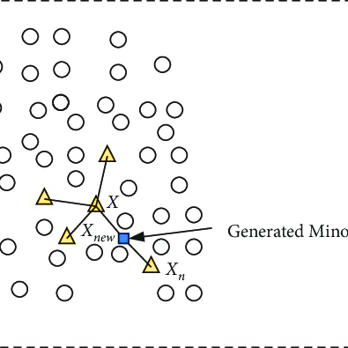
Data Preparation
Imbalanced Y Handling
Yes
16.1%
For the 4,092 employees, only 660 of them left the company in 2016, comprising only 16.1% of the entire dataset. This indicates a highly imbalanced target variable
No
83.9%
Synthetic Minority Oversampling Technique (SMOTE): addresses the class imbalance by augmenting the dataset with synthetic instances rather than by oversampling (which can lead to overfitting) or undersampling (which can lead to loss of information). For every instance in the minority class, SMOTE selects 'k' nearest neighbors and generates synthetic instances between the chosen instance and its neighbors.
8

Slide 10


Data Preparation
Exclude Variables
Index Columns: id, employeeID don't contain meaningful information for prediction; Including it can introduce noise and distort the model's accuracy
Constant Variable: Standard Hours
Time Variable: in_time, out_time
The phrase "弃之可惜，食之无味" in English can be translated as "It's a pity to discard it, but it's tasteless when eaten." It describes something that seems valuable but is actually not useful or enjoyable
9

Slide 11
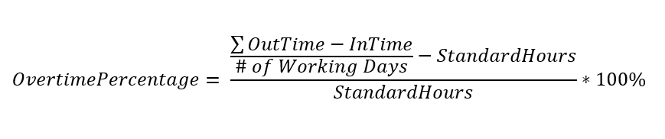

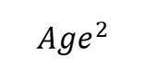
Data Preparation
Feature Engineering
01
New Feature:
overtime_percentage
Logrithm:
DistanceFromHome, MonthlyIncome, NumCompaniesWorked, TotalWorkingYears, YearsAtCompany, YearsSinceLastPromotion, YearsWithCurrManager
I love
Logarithms!
02
03
Polynomial (based on R^2 improvement):
Interaction Terms (based on R^2 improvement):
NumCompaniesWorked x TotalWorkingYears
overtime_percentage x YearsAtCompany
04
10

Slide 12
Modeling Approach: Decision Tree, k-NN, and Logistic Regression
Decision Tree
Utilized GridSearchCV for exhaustive parameter tuning
Explored various criteria, max_depth, min_samples_leaf, and min_samples_split
Rationale: Decision trees are interpretable and handle non-linear relationships well, suitable for exploring complex employee attrition patterns
k-NN (k-Nearest Neighbors)
Implemented StandardScaler for normalizing data
Tuned parameters including the number of neighbors and distance metrics
Rationale: k-NN is effective for identifying similar patterns, accommodating subtle attrition factors within a local context
Logistic Regression:
Applied L1 and L2 penalties for feature selection.
Experimented with a range of C values for regularization
Rationale: Logistic Regression provides probabilistic outcomes, aiding in understanding the likelihood of attrition based on individual features
11

Slide 13

Why this approach?
Comprehensive Exploration: Exhaustively searched parameter spaces for each model, ensuring optimal configuration.
Robust Evaluation: Employed nested cross-validation, providing a robust estimation of model performance, reducing overfitting risk
Balanced Data: Utilized SMOTE (Synthetic Minority Over-sampling Technique) to handle class imbalance, enhancing model accuracy
Interpretability: Decision trees offer interpretable rules, aiding in understanding attrition drivers
11

Slide 14
Limitations of this modeling method
Limited Feature Exploration:
The model's predictive power is constrained by the features available in the dataset. Factors not included might significantly impact attrition but are not accounted for in the model
Sensitivity to Hyperparameters:
The models' performance heavily relies on hyperparameter settings. Small changes in parameters, not exhaustively explored, could lead to different outcomes, impacting the model's stability and reliability
Overfitting Risks:
Complex models, especially decision trees with deep branches, might capture noise in the training data, leading to overfitting
Handling Dynamic Factors:
The model might not adapt well to changing attrition factors over time. Attrition drivers can evolve within an organization due to various factors, such as policy changes, economic shifts, or market demands, which the static model might not capture (more on this later...)
12

Slide 15
Modeling
Results
Decision Tree
kNN
Logistics Regression
criterion: entropy
max_depth: 20
min_samples_leaf: 1
min_samples_split: 3
knn_n_neighbors: 2
knn_weights: uniform
C=1
random_state=42
solver=liblinear
penalty: l2
Nested CV Accuracy:
0.8279 +/- 0.0297
Nested CV Accuracy:
0.8816 +/- 0.020
Nested CV Accuracy:
0.8425 +/- 0.0148
13

Slide 16
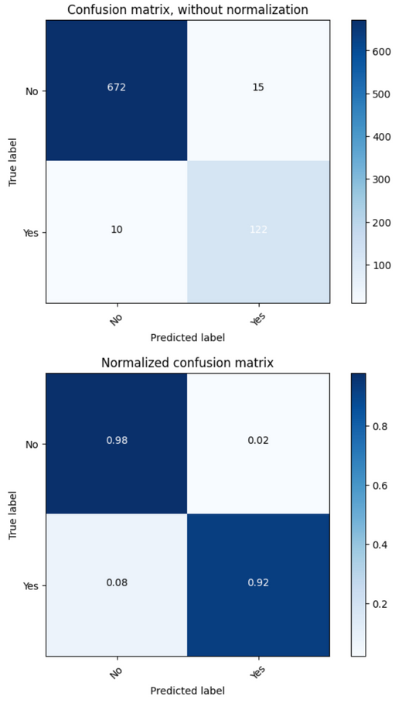

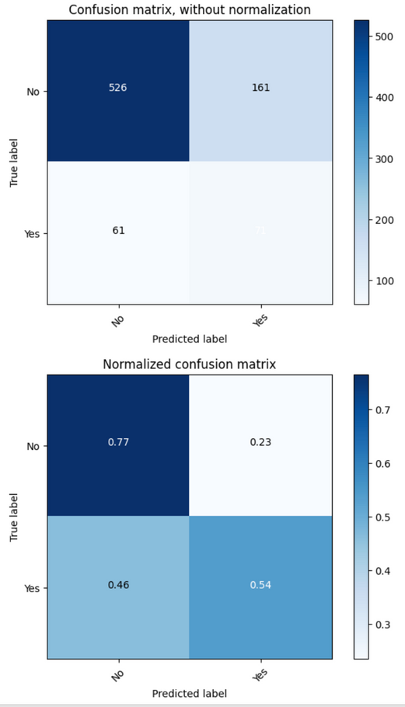
Evaluation
Confusion Matrix
Decision Tree
kNN
Logistics Regression
 | f1 | recall
Tree | 0.9697 | 0.9695
kNN | 0.9963 | 0.9963
LR | 0.7555 | 0.7289
122
129
71
14
Notes:
For our data modeling endeavors, our primary objective is to ensure no employee intending to leave the company is overlooked. However, it is also worth noting that the costs of an employee’s attrition are complex in nature. Consequently, for the model evaluation part, we prioritize maximizing Recall even if it results in offering benefits to those predicted to leave but who ultimately do not. Also, we investigate the utility of employee retaintion through Expected Value Analysis in model evaluation

Slide 17

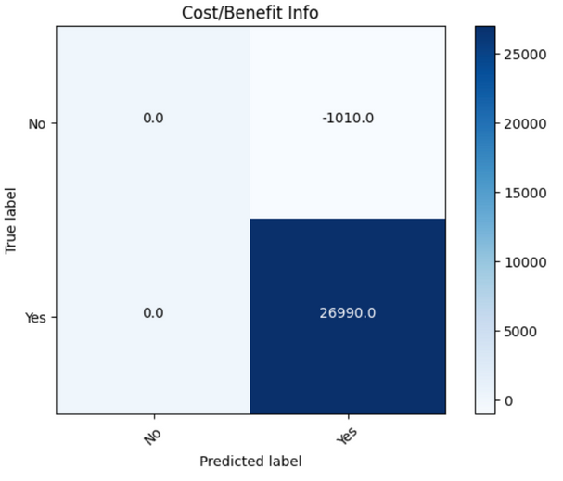
Evaluation
Expected Value
Educated assumption: calculated 34.78% (35%) of employees with attrition intent can be strategically retained if we correctly classify them.
“Negative Coworker Relationship”, “Feeling Undervalued”, and “Lack Support”
Cost (to save) of attrition = avg 6-9 month of salary = $80,000
Cost of data = 10 mins labor = $10
Cost of retention = 10 manager hours = $1,000
Quantitative Research Papers
b(Y,p): cost savings from retaining a valuable employee
- cost of (data collection + retention)
c(Y,n): costs of unnecessary retention efforts + data
c(N,p): no direct cost or benefit
b(N,n): no direct cost or benefit
Expected profit= $4001.99
15
Notes:
Important assumption: studying quantitative research of employee attrition and the effectiveness of retention strategies, we calculated that 39.13% (40%) of employees with attrition intent (mainly those because of “Negative Relationship with Coworkers”, “Feeling Undervalued”, and “Lack of Support” ) can be strategically retained if we correctly classify them.

Slide 18
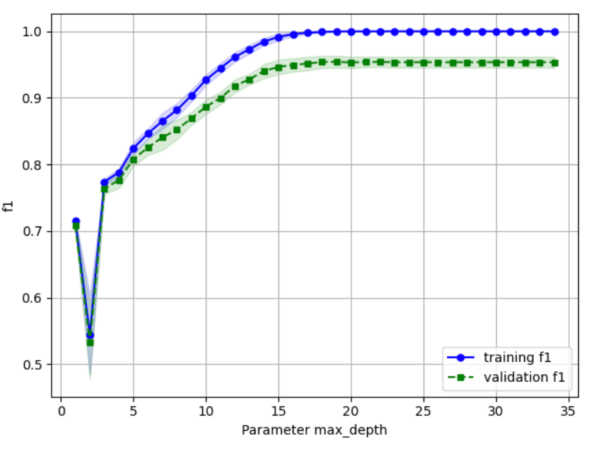
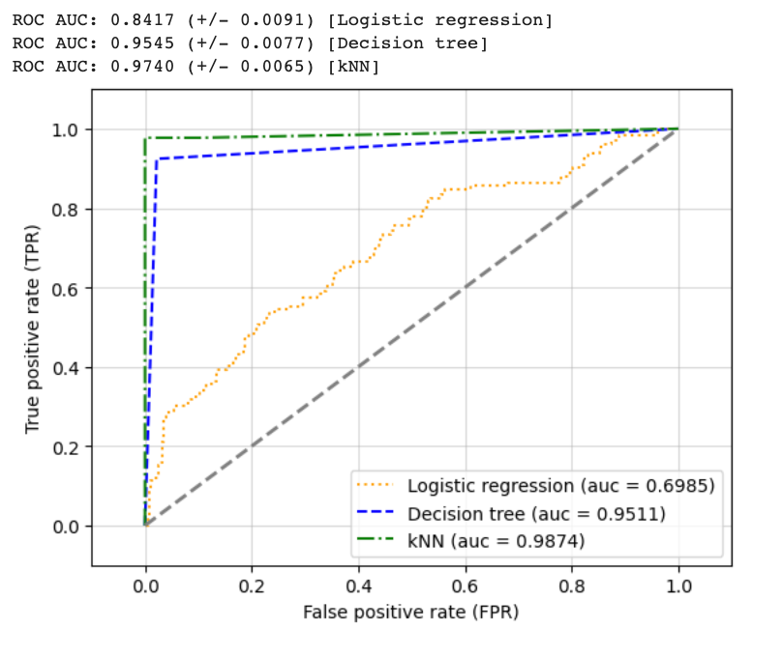
Evaluation
Model Performance
Fitting Graph
ROC-AUC
16

Slide 19

Deployment
Implementation
Create automated pipeline to query new data into HR’s designated database for this analysis
Train and evaluate MVP model
Iterate each quarter
Tool
feedback loop feature Function taking in new data and retrain & retune!
Ethical Consideration & Risks
Collecting and using employee data for prediction can raise privacy concerns.
Hash employee ID & critical info before training
Only report to team level for alertness & engagement improvement
Crucial to safeguarding sensitive information and implement robust security measures
Hiring managers and stakeholders may question or challenge decisions. Model interpretability and explanation mechanisms are vital for transparency Decision Tree
17

Slide 20
Citation
Human Resource Management (SHRM) Turnover Cost Calculation Spreadsheet. https://www.shrm.org/resourcesandtools/tools-and-samples/hr-forms/pages/turnover-cost-calculation-spreadsheet.aspx
Welch, Brantmeier. Examining Employee Retention and Motivation Trends in Research Administration. https://files.eric.ed.gov/fulltext/EJ1325462.pdf
The $12 Billion Opportunity in HR Technology
https://www.bcg.com/publications/2022/billion-dollar-opportunity-in-hr-technology
TrueList HR Statistics – 2023 https://truelist.co/blog/hr-statistics/
18

Slide 21
THANK YOU
19

